Slide 1
Data base management
MySQL
Postgre SQL
SQL Server
FALLAH Amani

Slide 2


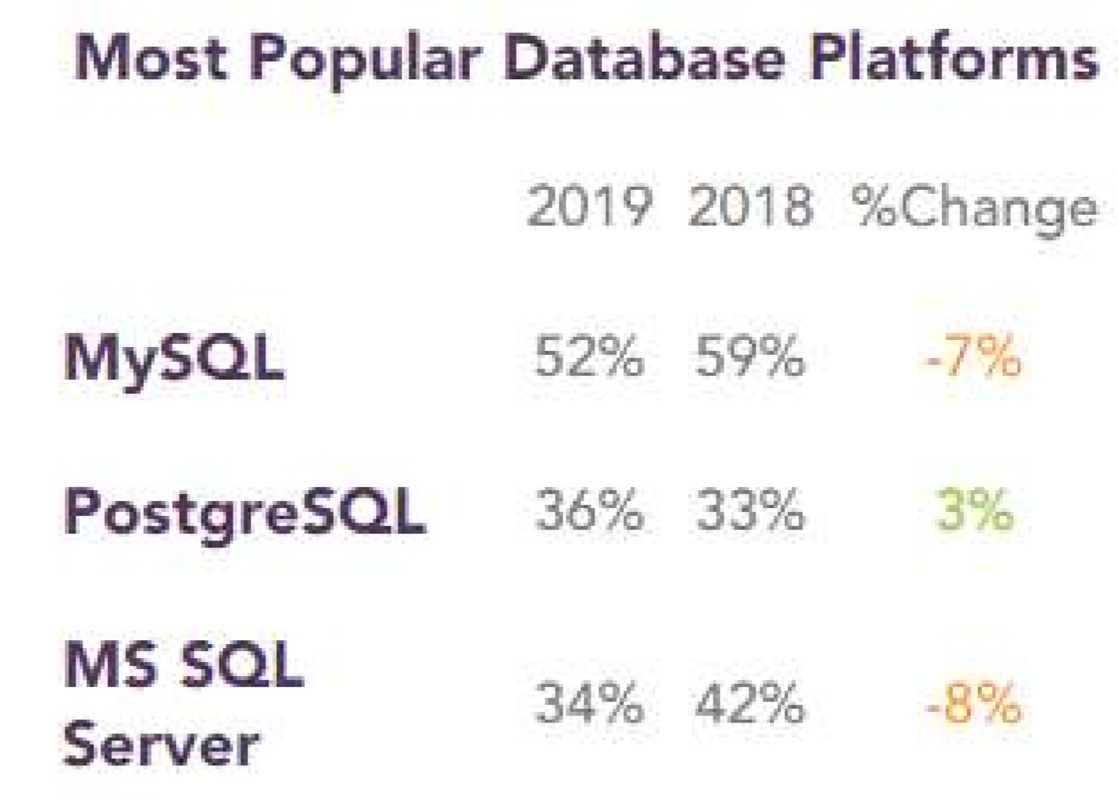
RDBMs are software systems that enable users to define, create, maintain and control access to relational databases.
Relational, because the databases’ tables are inter-jointed / inter-connected with a specific hierarchy (one-to-one, oneto-many and many-to-many).
So instead of having one gigantic table with multiple columns and rows we can divide this main table into interlinked sub-tables.
Making it easier to access data, to understand the database and to handle complex data configuration.

Slide 3
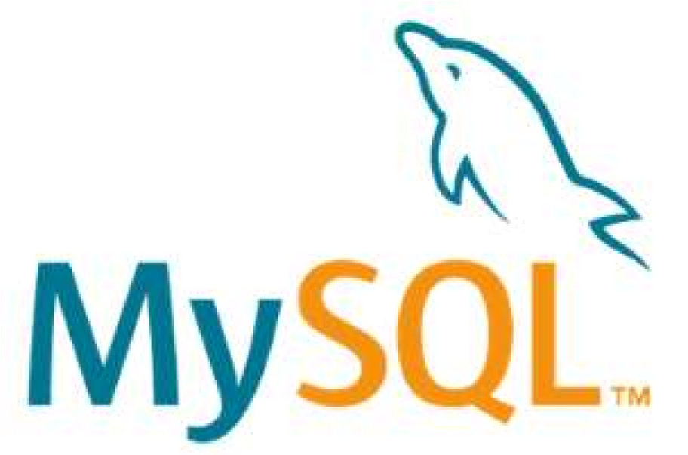
MySQL
MySQL is the most popular RDBMS. It was initially released the 23 May 1995 and written in C/C++. It is currently owned by Oracle Corporation.
It is used by many popular companies: Google, LinkedIn, Amazon, Netflix, Facebook, Twitter,
Youtube…
MySQL is open-source and benefits from a very big community.
As a RDBMS it uses a strict schema model (data inputs must strictly respect a certain schema without flexibility as in NoSQL) and relational nature of its data.
As a SQL (structured query language) it uses queries to obtain data via JOINS to join / connect tables together.
Compared to NoSQL, SQL allows to automatically update data redundant in different parts of the databases.

Slide 4
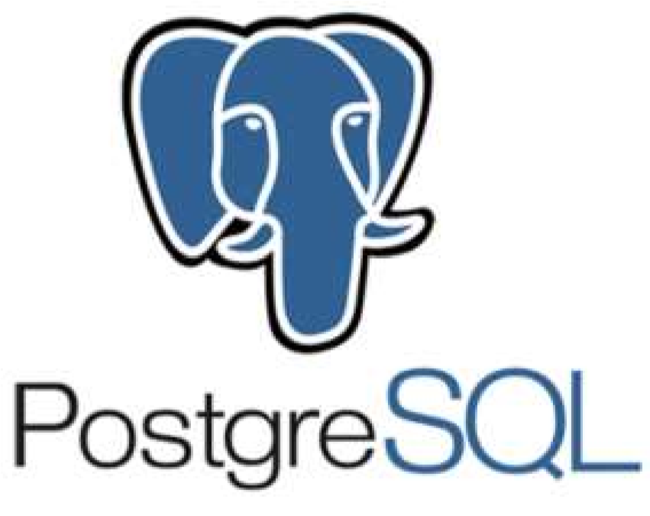
Postgre SQL
Postgre SQL is the second most popular RDBMS. It was initially released the 8 July 1996 and written in C.
It is developed and owned by Owned by PostgreSQL Global Development Group. It is used by many popular companies: Cisco, Apple, Skype… MySQL is open-source and benefits from a very big community.
As a RDBMS it uses a strict schema model (data inputs must strictly respect a certain schema without flexibility as in NoSQL) and relational nature of its data.

Slide 5
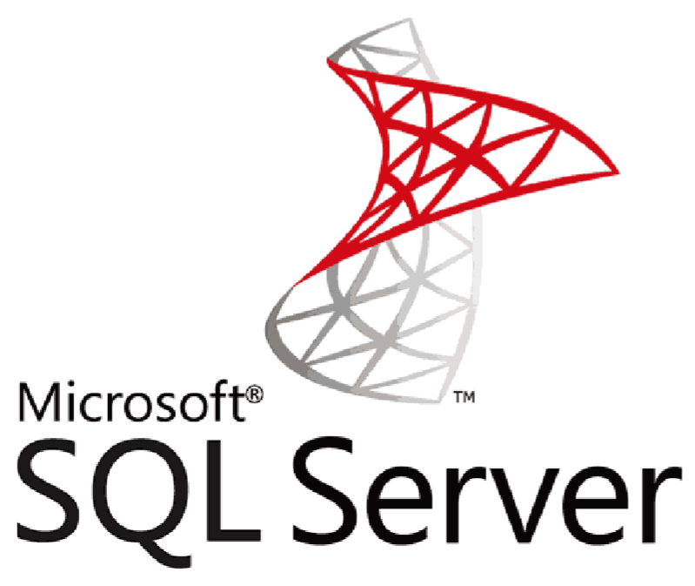
SQL Server
SQL Server is also a RDBMS. It was initially released the 2 April 1989 and written in C,C++ and C#. It was developed and owned by Microsoft.
It is used by many popular companies: EdgeWood College, Palo Alto University, Palo Alto
University…

Slide 6
